Slide 1
Infection Propagation Problem
Akshit Arora
Prashil Bhimani
CSCI 5454 - Design and Analysis of Algorithms

Slide 2
Outline
Problem Definition
Problem Formulation
Sample Problem Illustration
Approaches
Similarity to P-Space Problems
Results
Limitations
Future Work

Slide 3
Problem Definition
A network of connected computers
Infection starts with 1 computer and can propagate only if there is a connection between the 2 computers
Infection cannot propagate via a safe computer
Protector can mark any one computer as a safe computer by shutting it down
The infection ends when no more nodes can be infected or the protector cannot mark any more computers as safe
Goal is to minimize the the number of infected nodes

Slide 4
Problem Formulation
The problem is formulated as a 2 player graph game.
Each computer is a node and each connection is an edge.
The infection can choose any one node to infect from the neighbours of the already infected nodes which are not safe
The protector can choose any one node which is neither safe or infected to save.
Each player will select only one node at a time

Slide 5
Sample Problem
 | Infected
 | Safe
 | Available

Slide 6
Approches
Greedy Approach
Not optimal
In worst case will infect N/2 nodes
Node Ranking
Not optimal
Does not take into consideration the start point and the current status of infection
MiniMax Algorithm
Alpha Beta Pruning
BFS Pruning
Notes:
prashil

Slide 7
MiniMax Algorithm
MiniMax Tree is generated from the graph
A leaf nodes is given the value of it’s depth
Every path from the root to a leaf node will define strategy
The protector is trying to minimize the the length of this path and the attacker is maximizing the same
Notes:
Show a sample tree on white board
prashil

Slide 8
Alpha Beta Pruning
It stops completely evaluating a move when at least one possibility has been found that proves the move to be worse than a previously examined move.
The algorithm maintains two values:
Alpha - the minimum score for max. Player
Beta - the maximum score for min. player
Initially Alpha is -inf. and Beta is +inf.

Slide 9
BFS pruning
From the start of the infection the infection will reach a particular node in at least n steps where n is its shortest distance from that node
If there are K nodes at depth M and if K< M we do not need to consider the nodes after depth M
Notes:
Show a sample tree on white board
prashil

Slide 10
Similarity to PSPACE problem
Generalized Geography
Only chooses one path
Back edges can be represented as the leaf nodes of MiniMax Tree.
Notes:
Show a sample tree on white board

Slide 11
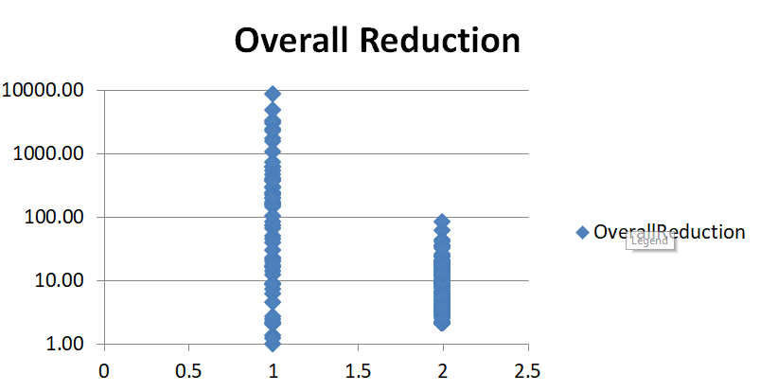
Results
Average reduction for Edge/Node ratio
1 | 2
455.64 | 16.96

Slide 12
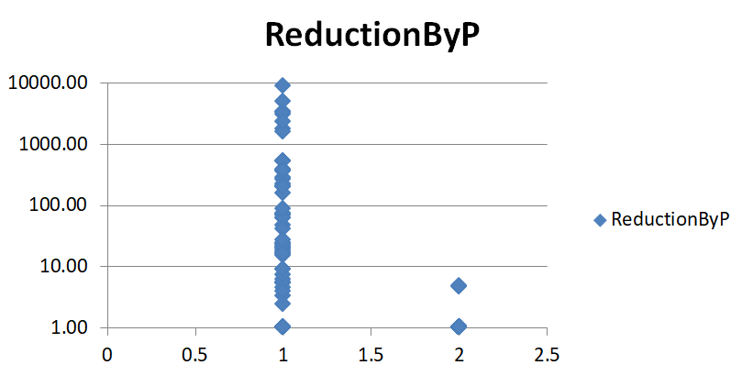
Results
Average reduction for Edge/Node ratio
1 | 2
281.25 | 1

Slide 13
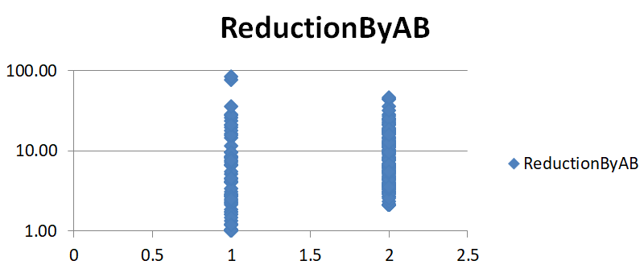
Results
Average reduction for Edge/Node ratio
1 | 2
5.32 | 16.96

Slide 14
Limitations
The current problem definition is very limited in scope as to the speed with which the infection is spreading and that the infection can only add one node at a time
The proposed algorithms works well for sparse graph but the efficiency decreases as the graph becomes more dense
Approximate approaches may not give the optimal solution but will definitely may be a lot quicker
Notes:
Show a sample tree on white board

Slide 15
Future Work
Try to fit the problem to one of the standard PSPACE or Exponential problems to prove that the efficiency cannot be further optimized without loss of optimality
Use the concept of honeypots (deception) in the network. (Aggarwal, P., Gonzalez, C., & Dutt, V. (2016))
Notes:
Show a sample tree on white board

Slide 16
Thanks!
Thanks to EECS, UC Berkeley for alpha-beta pruning animation: http://inst.eecs.berkeley.edu/~cs61b/fa14/ta-materials/apps/ab_tree_practice/

Slide 17
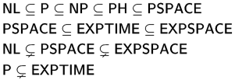
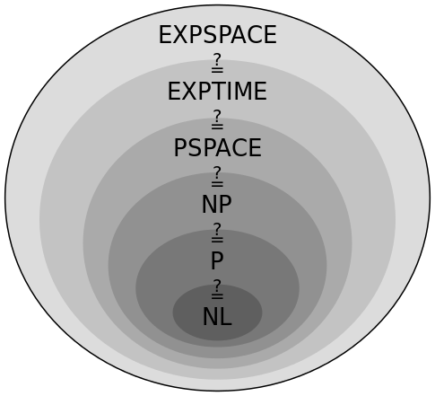
PSPACE problem
In computational complexity theory, PSPACE is the set of all decision problems that can be solved by a Turing machine using a polynomial amount of space.
Notes:
Show a sample tree on white board

